Slide 1

UNIVERSITY INSTITUTE OF ENGINEERING
DEPARTMENT OF AIT - CSE
Bachelor of Engineering (CSE)
Security and Data Privacy Laws and Standards (21CSF-433)
By: Ms. Merry K.P(E12903)
Assistant Professor
AIT CSE
Lecture -2
Trusted Operating System Design
DISCOVER . LEARN . EMPOWER

Slide 2
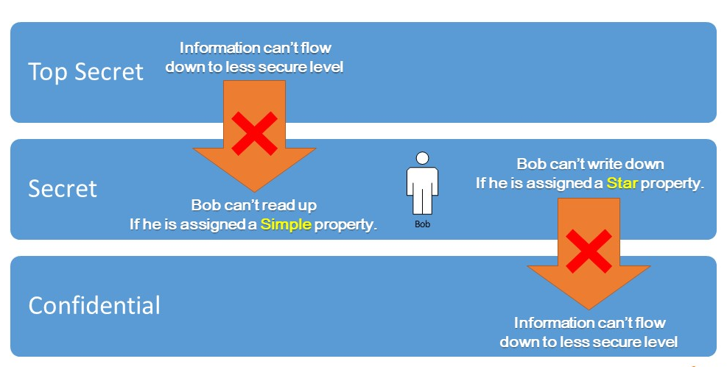
Bell-La Padula Model (BLP)
Developed by David Elliott Bell and Leonard J. LaPadula, it is a state machine (mathematical model for computation) model used to enforce access control in government and military applications.
The Bell and La Padula model [BEL73] is a formal description of the allowable paths of information flow in a secure system
BLP model focuses on data confidentiality and controlled access to classified information.

Slide 3
Chapter | Course Objectives
1. | Exhibit knowledge to secure corrupted systems, protect personal data, and secure computer networks in an organization.
Chapter | Course Outcomes
1. | After completion of this course, the student will be able to Know how to secure corrupted systems. Aware of personal data protection and secured networking.

Slide 4
Contents
1.1 Designing Trusted Operating Systems
Trusted operating system design

Slide 5
Bell-La Padula Model (BLP)
The Bell-LaPadula security model deals with the preservation of confidentiality, and only confidentiality. Why? Because the government is all about keeping secrets. Lots of different types of secrets with varying levels of secrecy that require different types of classification labels.
Example 1
The truth about the existence of space aliens would probably be something that is Top Secret.
Example 2
Compared to aliens, the statistics on the number of Army officials unofficially fighting with the Pakistan in Borders would probably be labeled a Secret.
Example 3
What about the number of staplers being delivered to the Rashtrapathibhavan? It seems like a trivial piece of information, but according to the government it could also be considered a secret. It's not as secretive as aliens or military commandos, so it might just get a classification label of "Confidential".

Slide 6
Bell-La Padula Model (BLP)
All these types of secrets may one day have to traverse from one secure system to the next. Intelligence may need to go from a server that is Secret, to a server that is Top Secret.
This was why The Bell-LaPadula model was created, to manage a multi-level security system.
To manage the flow of different types of secrets, the Bell-LaPadula model utilizes 3 rules:
The Simple Security Rule - A person in one classification level, cannot read data in a higher classification level. If you have a Secret clearance, then you cannot read objects with a label of Top Secret. This is also known as No Read Up.
The Star Property Rule - A person in a higher classification level, cannot write messages to someone in a lower classification level. If you have a clearance of Top Secret, then you cannot write messages to someone with a Secret clearance. This is known as No Write Down.
The Strong Star Property Rule - A person in one classification level cannot read or write intelligence to any other classification level. If you have a clearance of Secret, then you are only allowed to read and write data to objects with the same classification label.

Slide 7
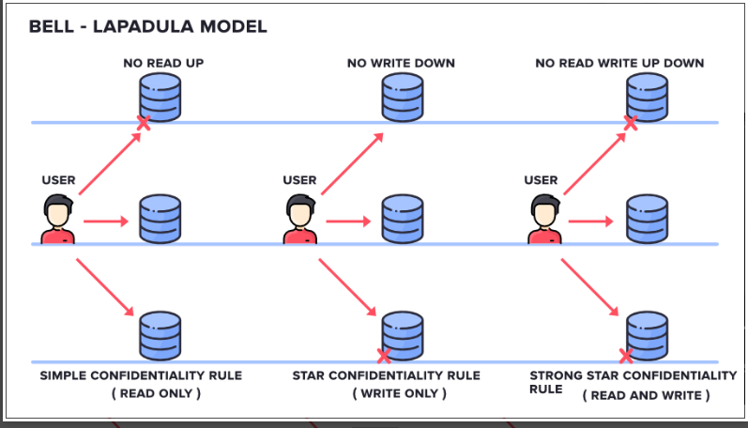
Bell-La Padula Model (BLP)

Slide 8
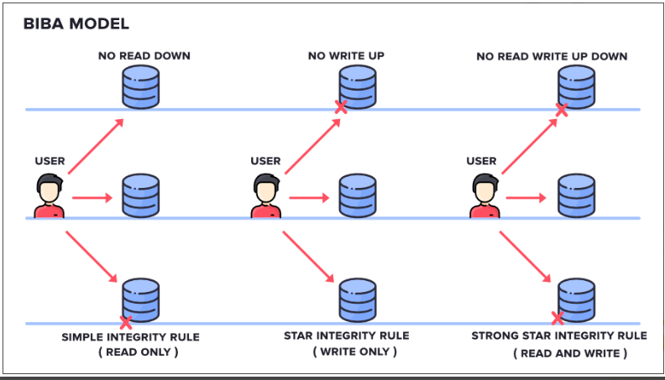
Biba Integrity Model
Kenneth J. Biba developed Biba Model or Biba Integrity Model in 1975.
It is a formal State Transition System (a concept used to study computation) of computer security policy that describes a set of access control rules designed to ensure Data Integrity.

Slide 9
Biba Integrity Model
It has mainly 3 Rules:
SIMPLE INTEGRITY RULE: Simple Integrity Rule states that the Subject can only Read the files on the Same Layer of Secrecy and the Upper Layer of Secrecy but not the Lower Layer of Secrecy, due to which we call this rule as NO READ DOWN
STAR INTEGRITY RULE: Star Integrity Rule states that the Subject can only Write the files on the Same Layer of Secrecy and the Lower Layer of Secrecy but not the Upper Layer of Secrecy, due to which we call this rule as NO WRITE-UP
STRONG STAR INTEGRITY RULE

Slide 10
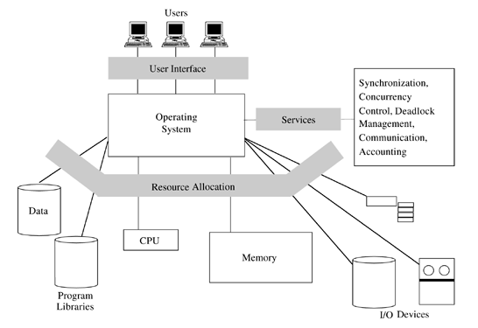
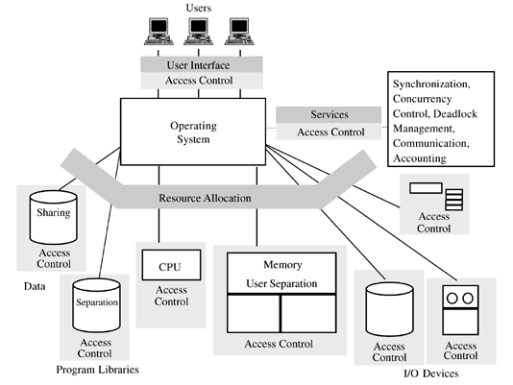
Traditional OS V/S Trusted OS

Slide 11
Cont…
There are three primary services of operating systems that interact with security aspects.
User Interface | authenticates a user, allows him access to the system, and handles all interaction with the user.
Service Management | allows a user access to many of the low-level services of the operating system.
Resource Allocation | allocates resources requirements for the user, such as memory, I/O devices, time on the CPU, etc.

Slide 12
Cont…
In a typical TOS design initiated with security in mind from the beginning, each of these primary services is written with a distinct object along with necessary security controls. Especially user authentication and complete intervention.
Some of the features of a security-oriented operating system that are not obvious,
Mandatory access control (MAC)
Object reuse protection
Audit log management
Intrusion detection

Slide 13
Features of a security-oriented operating system
Mandatory access control (MAC) refers to the granting of access by a central authority, not by individual users. If I have SECRET data to show you and you do not have a SECRET clearance, I cannot of my own volition grant you a SECRET clearance (although I have actually seen it done – I wonder what the Defense Department would think of that). MAC should exist along with discretionary access control (DAC) in that objects not managed by the central authority can be managed by the individual user owning them.
Object reuse protection refers to the complete removal of an object before it is returned to the object pool for reuse. The simplest example of this is protection of files. What happens when a file is deleted. In many operating systems, the file allocation table is modified to no longer reference the object and to place its data sectors on the free list as available for reuse. Note that the data sectors are not overwritten, so that the original data remains. In theory, I could declare a large file and, without writing anything to it, just read what is already there, left over from when its sectors were used by a number of other files, now deleted.

Slide 14
Cont…
Audit log management refers to the practice of logging all events with potential security impact, protecting that log from unauthorized access and modification, and creation of procedures and software to examine the log periodically and analyze it for irregularities. A security log is of no use if nobody looks at it.
Intrusion detection refers to the creation and use of system software that scans all activity looking for unusual events. Such software is hard to write, but one should try. For example, this author has a 128 MB flash drive that he occasionally attaches to his computer at work via the USB port. The intrusion detection software always reports that the number of hard drives on the system has changed and says to call the administrator if this was not an intentional act.

Slide 15
The Trusted Computing Base (TCB)
The trusted computing base is the name given to the part of the operating system used to enforce security policy. Naturally, this must include the security kernel. Functions of the TCB include the following:
1) hardware management, including processors, memory, registers, and I/O devices,
2) process management, including process scheduling,
3) interrupt handling, including management of the clocks and timing functions, and
4) management of primitive low-level I/O operations.

Slide 16
Tools of a TOS
Virtualization is one of the most important tools of a trusted operating system. By this term we mean that the operating system emulates a collection of the computer system’s sensitive resources. Obviously virtualized objects must be supported by real objects, but the idea is that these real objects can be managed via the virtual objects.
As an example of a virtualized object, consider a shared printer. The printer is a real object to which it is possible to print directly. Simultaneous execution of several programs, each with direct access to the printer would yield an output with the results of each program intermixed – a big mess. In fact the printer is virtualized and replaced by the print spooler, which is the only process allowed to print directly to the printer. Each process accessing the virtualized printer is really accessing the print spooler, which writes the data to a disk file associated with the process. When the process is finished with the printer, the spooler closes the file, and queues it up for being printed on the real printer.
A virtual machine is a collection of hardware facilities, each of which could be real or simulated in software. One common feature is virtual memory, in which each process appears to have access to all of the memory of the computer, with the possible exception of memory allocated to the operating system.

Slide 17
Trusted System Design Elements
Good design principles are always good for security, several important design principles are quite particular to security and essential for building a solid, trusted operating system.
Least privilege. Each user and each program should operate by using the fewest privileges possible. In this way, the damage from an inadvertent or malicious attack is minimized.
Economy of mechanism. The design of the protection system should be small, simple, and straightforward. Such a protection system can be carefully analyzed, exhaustively tested, perhaps verified, and relied on.
Open design. The protection mechanism must not depend on the ignorance of potential attackers; the mechanism should be public, depending on secrecy of relatively few key items, such as a password table. An open design is also available for extensive public scrutiny, thereby providing independent confirmation of the design security.

Slide 18
Cont…
Complete mediation. Every access attempt must be checked. Both direct access attempts (requests) and attempts to circumvent the access checking mechanism should be considered, and the mechanism should be positioned so that it cannot be circumvented.
Permission based. The default condition should be denial of access. A conservative designer identifies the items that should be accessible, rather than those that should not.
Separation of privilege. Ideally, access to objects should depend on more than one condition, such as user authentication plus a cryptographic key. In this way, someone who defeats one protection system will not have complete access.
Least common mechanism. Shared objects provide potential channels for information flow. Systems employing physical or logical separation reduce the risk from sharing.
Ease of use. If a protection mechanism is easy to use, it is unlikely to be avoided.

Slide 19
Summary
Introduction to Trusted Operating System (TOS)
Difference between Traditional OS & Trusted OS
Importance of TOS Models Bell-La Padula and Biba integrity

Slide 20
Home Work
Q1. What is the need for a trusted operating system?
Q2. What do you mean by access control in TOS?

Slide 21
References
Text Books:
V. D. Dudeja ,”Cyber Crime and Law Enforcement”, Commonwealth Publishers, 2003.
C. Davis,”IT Auditing: Using Controls to protect Information Assets”, TMH, 2011.
Reference Books:
G.E. Kennedy & L.S.P. Prabhu, “Data Privacy Law: A Practical Guide”, Interstice; 2nd edition, 2017.
June M. Sullivan & Shannon B. Hartsfield, “HIPAA: A Practical Guide to the Privacy and Security of Health Data”, American Bar Association; 2nd edition, 2020.
Journals:
Pankaj Sharma, “Cyber Surveillance & Data Privacy Law: The Reconciliation”, https://www.researchgate.net/publication/335378068_Cyber_Surveillance_Data_Privacy_Law_The_Reconciliation?channel=doi&linkId=5d60da79a6fdccc32cccd626&showFulltext=true, 2019.
Online References:
Designing Trusted Operating System: https://slideplayer.com/slide/9081213/
Need for Trusting an Operating System: https://www.youtube.com/watch?v=d8n712XUpo8

Slide 22
THANK YOU
For queries
Email: merry.e12903@cumail.in

